Slide 1

As a 90s Kid didn’t you ever had a wish that you could somehow get the magic wand.

Slide 2
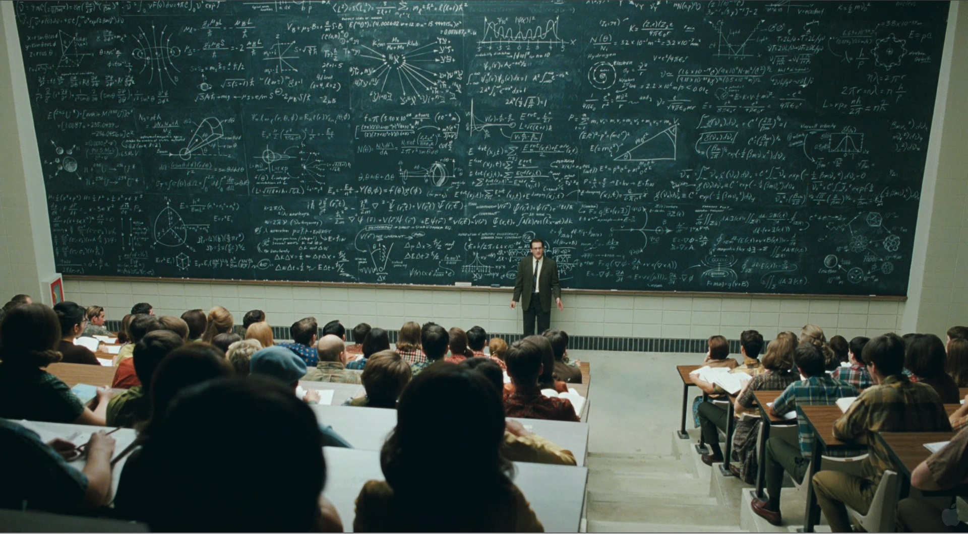
Has this ever happened with you in class, that you are confused about, whether to listen to the professor or whether to write down his notes??

Slide 3
Wouldn’t it be Awesome if, whatever professor is writing on the board magically gets converted into text and comes to us in the pdf format.

Slide 4
Hello!
Group-3
Jitendra Jangid 14CE10023
Rajat Gupta 14CE10044
Sahil Khare 14CE10046
Sanat Kumar Saha 14CE10048
Vaishali Singh 14CE10058

Slide 5
Our Project
Digit Writing-Hand Gesture Recognition
(Using accelerometer data)

Slide 6
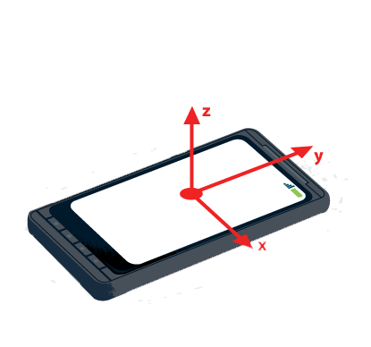
Our Project
Real Time Accelarometer data is used available from mobile accelarometer.
Frequency of data collection is 100Hz.
Could Predict Digits between 0-9.
Uses Classification algorithms to classify
various digits.

Slide 7
Basic Steps
Data Collection
Data Pre-processing
Model Training
Real Time Testing

Slide 8
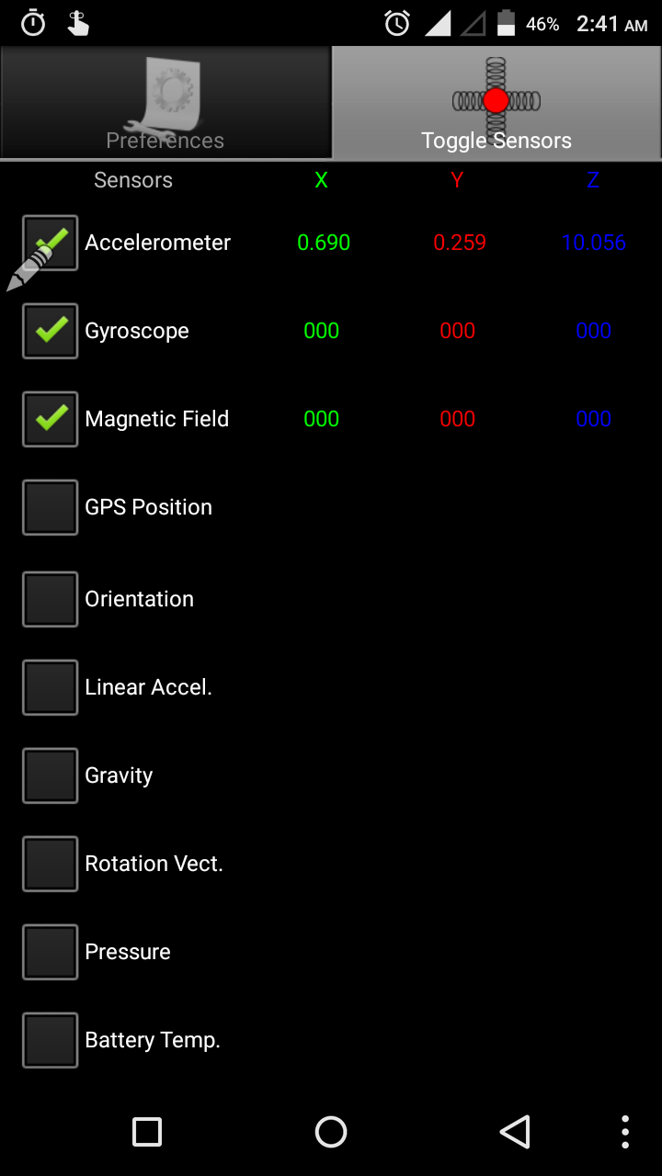
Data Collection
App named ‘IMU+GPS-Stream’ has been used to collect data.
Around 1600 datasets have been collected for digits from 0-9.
App gives 100 readings of acceleration in X,Y and Z directions in 1 second.
Analysis is done in X-Y Plane.

Slide 9
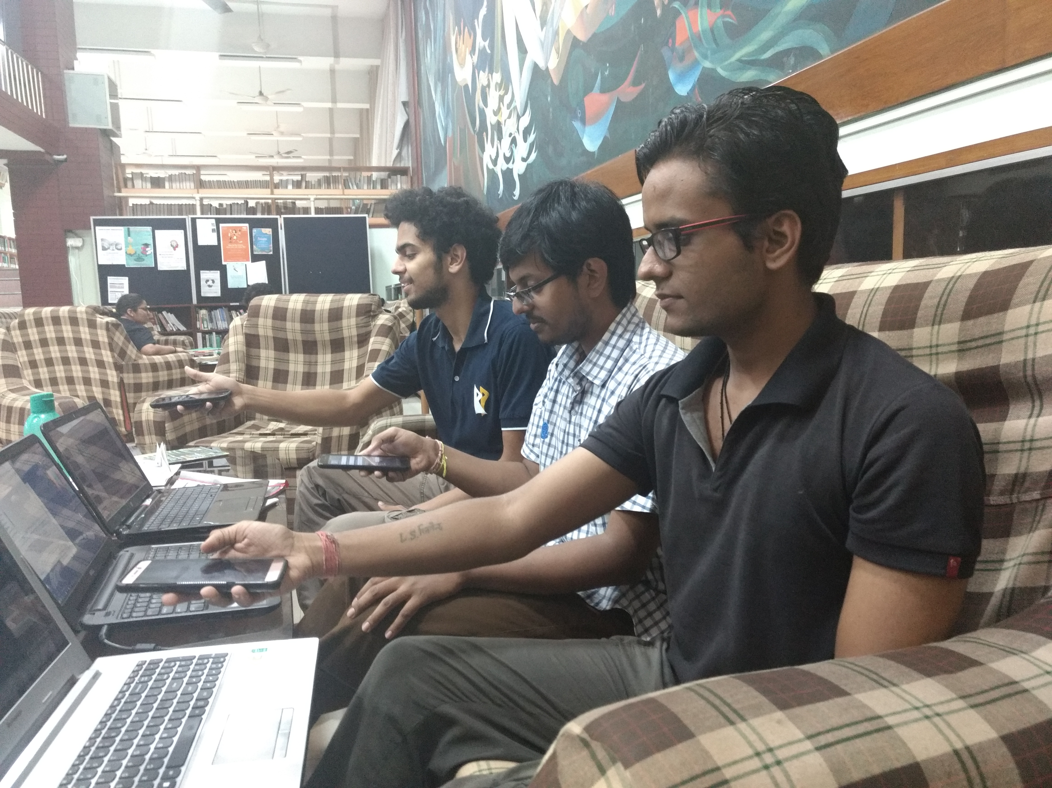
Data Collection

Slide 10

Data Cleaning
Extracting the data about x-and y-axis only
Normalizing each DataStream on the basis of the maximum value of acceleration [Final Range: -1 to 1]

Slide 11
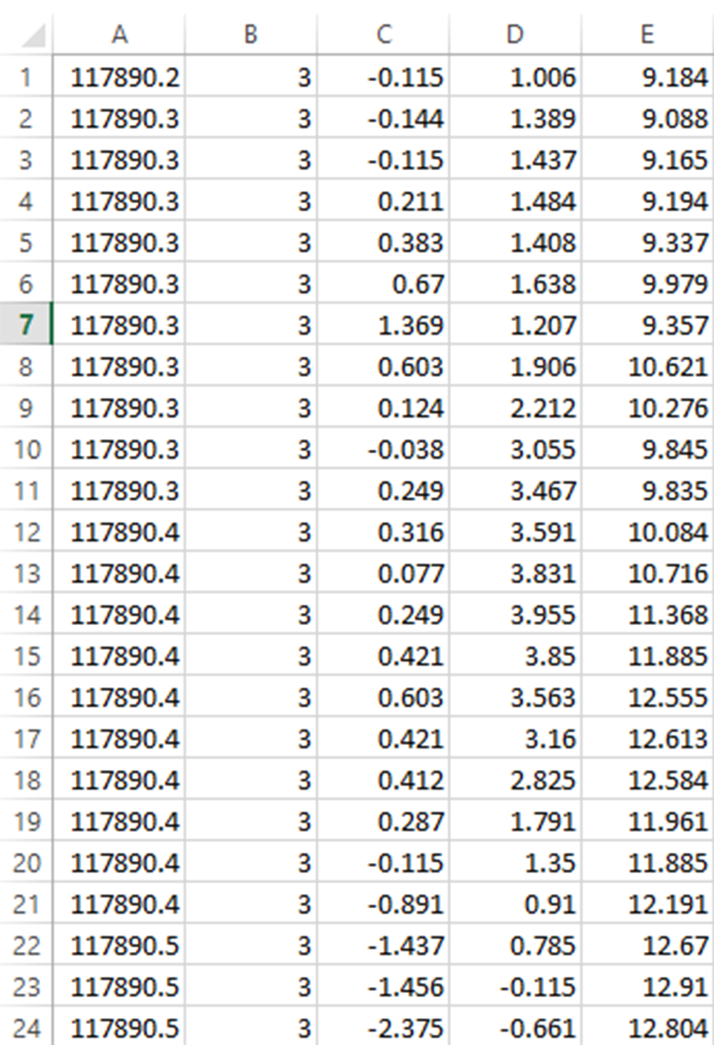
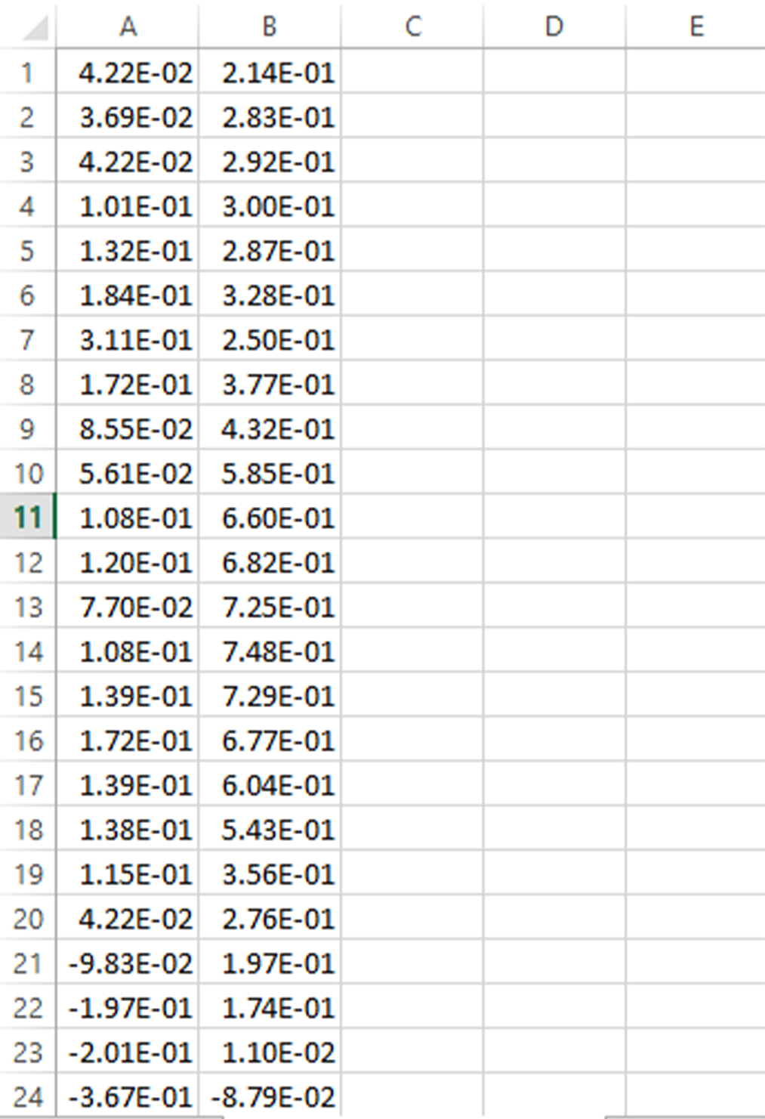
Raw Data
Cleaned Data

Slide 12
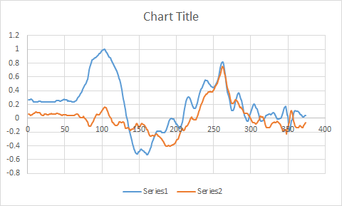
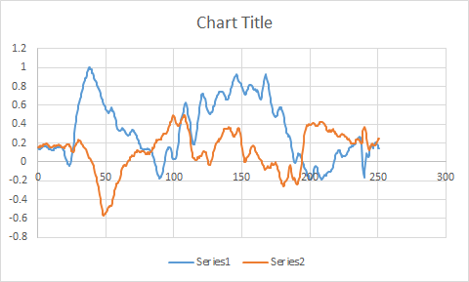
Inference from Data
For digit 0
For digit 7

Slide 13

Feature Extraction
Nx2 DataStream matrix
24 features per axis i.e. 48 features per DataStream
1x48 Feature matrix

Slide 14
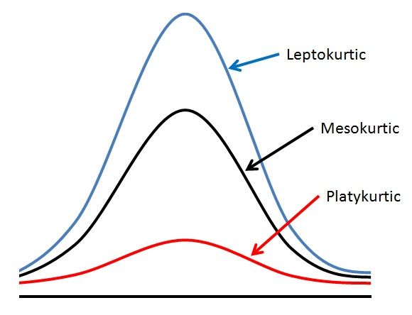
Feature extraction
Minimum value, maximum value, first difference mean, first difference max, second difference mean and second difference max
Standard deviation
Measure of variation or deviation of data from the mean value
Kurtosis
Measure of tailedness of a given data set

Slide 15
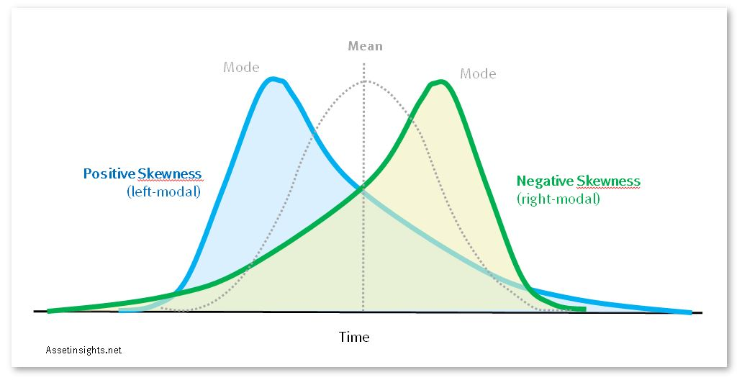
Feature extraction
Skewness
Measure of asymmetry of a given data set
Hjorth mobility
Mean frequency or the proportion of standard deviation of the power spectrum
Mobility = $\frac{σ^{′}}{σ}$
Hjorth complexity
Represents the change in frequency
Complexity = $\frac{{σ′′}/{σ′}}{{σ′}/σ}$

Slide 16
Feature extraction
Frequency Analysis
FFT-Converts signals from time domain to frequency domain. Eg – FFT Delta, Theta, Alpha, Beta
Wavelet features
Eg – mean, standard deviation, energy and entropy

Slide 17

Model Training
Decision Tree
KNN
Logistic Regression
SVM
ANN
XGBoost

Slide 18
Decision Tree
Decision tree is a type of supervised learning algorithm (having a pre-defined target variable) that is mostly used in classification problems.
It works for both categorical and continuous input and output variables.
In this technique, we split the population or sample into two or more homogeneous sets (or sub-populations) based on most significant splitter / differentiator in input variables.
Used K – Fold cross validation (K=10) with setting the impurity parameter i.e Gini Impurity to 10⁻⁵ and achieved 60% average accuracy on test dataset.
1

Slide 19
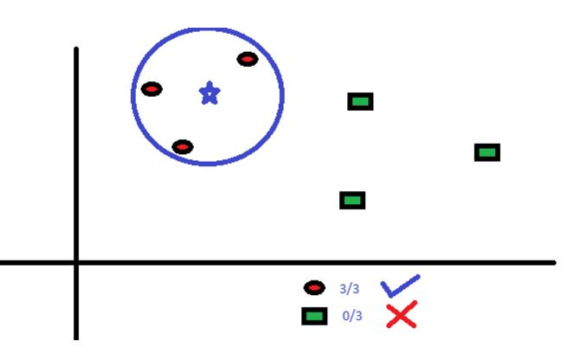
K-nearest neighbours
KNN can be used for both classification and regression predictive problems.
Used K – Fold cross validation (K=10) with setting the N parameter to 15 and achieved 66% average accuracy on test dataset.
2

Slide 20
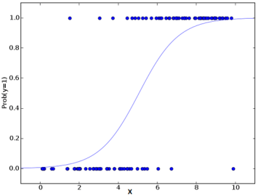
Logistic Regression
Logistic Regression is a classification algorithm.
Logistic regression as a special case of linear regression when the outcome variable is categorical, where we are using log of odds as dependent variable(log of odds = log(p/1-p)).
Used K – Fold cross validation (K=10) with
setting the C( Inverse of Regularization) parameter to
10000 and achieved 77% average
accuracy on test dataset.
3

Slide 21
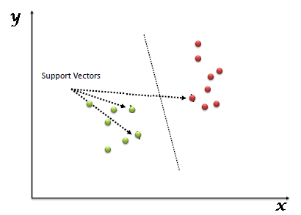
SVM(Support Vector Machine)
SVM is a supervised machine learning algorithm which can be used for both classification or regression challenges.
In this algorithm, we plot each data item as a point in n-dimensional space (where n is number of features) with the value of each feature being the value of a particular coordinate. Then, we perform classification by finding the hyper-plane that differentiate the two classes very well.
Used K – Fold cross validation (K=10) with
Polynomial Kernel and achieved 73%
average accuracy on test dataset.
4

Slide 22
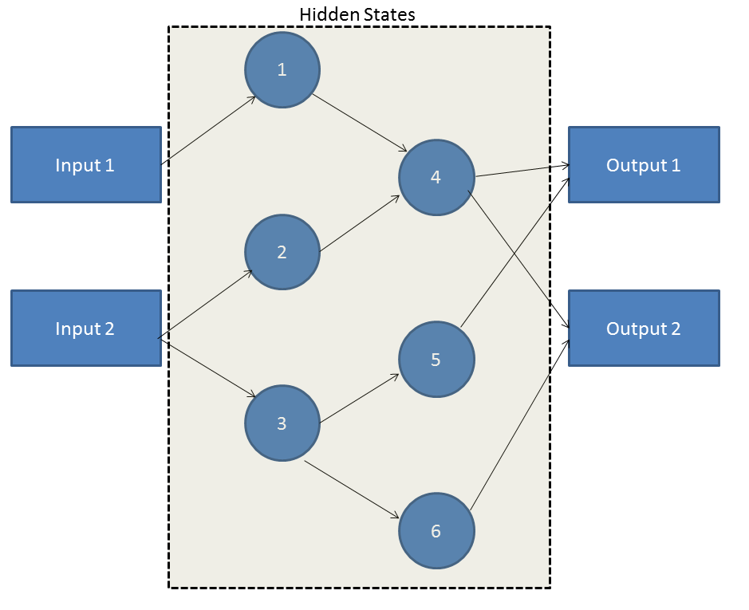
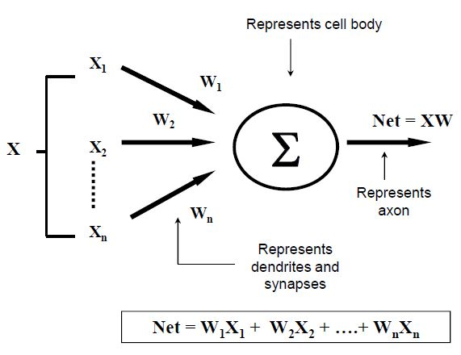
ANN(Artificial Neural Network)
Working of ANN takes its roots from
the neural network residing in human brain.
ANN operates on something referred
to as Hidden State and these hidden states
are similar to neurons.
Each of these hidden state is a transient
form which has s probabilistic behavior.
A grid of such hidden state act as a bridge
between the input and the output.
Used K – Fold cross validation (K=10) with
setting the hidden_layer_sizes(46,42), tanh
activation function and Alpha(1e-4) parameters
and achieved 66% accuracy on test dataset.
5

Slide 23
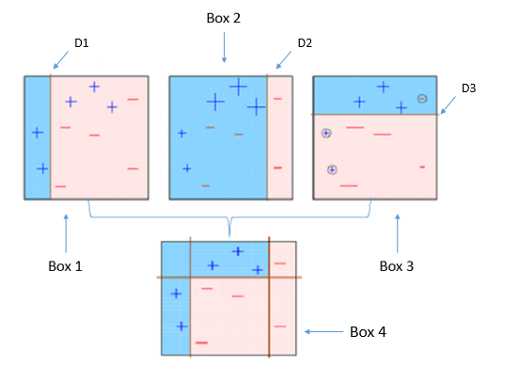
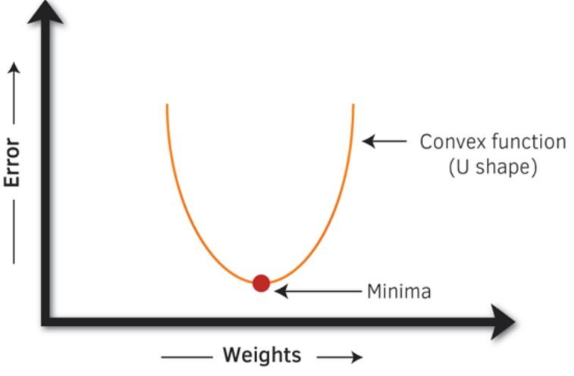
Extreme Gradient Boosting(XGB)
XGBoost is an optimized distributed gradient boosting library.
XGBoost belongs to a family of boosting
algorithms that convert weak learners into
strong learners.
In simple words, gradient boosting tries to
optimize the loss function by tuning different
values of coefficients to minimize the error.
Used K – Fold cross validation (K=10) with
parameter tuning learning_rate(0.1),
n_estimators(500), max_depth(3), objective
(multi:softmax) and achieved 80% accuracy
on test dataset.
6

Slide 24
Model Performance

Slide 25
Why do you think XGBoost is the best technique for this particular problem?
Using the boosting approach along with the 10-fold cross validation of the XGBoost techniques it gives a great boost up to the accuracy, by lowering the RMSE value and ensures a more robust prediction model.
XGBoost readily take care of the low relative influenced variable amongst the data given, and deals with higher correlation variables without over-fitting.

Slide 26

Real Time Testing
Mobile device is connected to laptop’s hotspot
DataStream consisting of 256 data points is stored in a numpy array
1x48 feature matrix is generated and fed it to our model to recognize the gesture

Slide 27

Programming Tools Used
Language
Python
Libraries
sklearn, numpy, scipy etc.

Slide 28
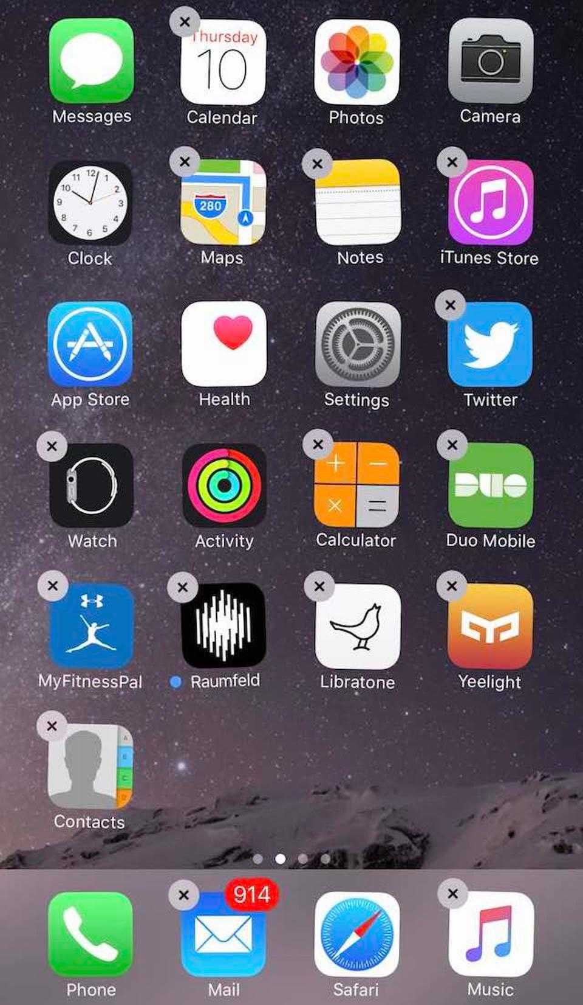
Place your screenshot here
Applications
Automation of things for physically challenged people
Smart homes
Gesture controlled robots
Gaming
Cost effective human computer interface

Slide 29
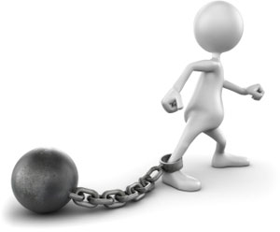
Limitations
Dependent on the time elapsed to draw the number
Numbers can be drawn in different ways
Accelerometer data from the mobile not pretty accurate
Only data in X-Y plane has been used to draw the numbers

Slide 30

version to text while writing
Future Projections
Automatic conversion to text while writing
Advanced Gaming

Slide 31
References
Analytics Vidya
“Automated analysis of Long-Term EEG Signals”, Czech Technical University

Slide 32
